Slide 1
Pediatric Dermatology August 2014
Pediatric Continuity Clinic Curriculum
Created by: Erin Garrigan

Slide 2
Objectives
Describe and recognize pediatric dermatological conditions that may present in the head and neck.
Understand the differential diagnosis of these conditions and be able to identify the most common associated conditions or complications
Be able to discuss management options and complications of treatment

Slide 3
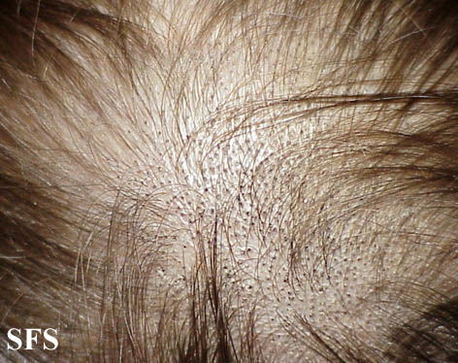
Case #1
A 4 y.o previously healthy male presents to your clinic with a one week history of frequent itching in the scalp area. Mother has noticed a flaky patch and she is concerned that there is hair loss in this area. She applied oil to his hair but nothing has helped. The patch does not fluoresce under wood’s lamp
Healthhype.com

Slide 4
What is the most likely cause of his condition?
T cell mediated immune response against the hair follicle
Trichophyton tonsurans
Microsporum canis
Treponema pallidum
Self inflicted

Slide 5
What is the most likely cause of his condition?
T cell mediated immune response against the hair follicle
Trichophyton tonsurans
Microsporum canis
Treponema pallidum
Self inflicted
An endothrix infection (e.g trichophyton) resides within the hair shaft, thus systemic treatment is needed to target the fungus. Black dots are present in the photo indicating broken hair flush with the scalp. Endothrix species do not fluoresce under wood’s lamp. An ectothrix (e.g. microsporum) in contrast will fluouresce, and is located with spores on the outer portion of the hair shaft. T cell mediated immune response may be seen in alopecia areata and scaling would expected to be absent in this case.

Slide 6
To identify spores of the suspected organism, the following techniques should be used…
Examine a skin scraping of scale under the microscope with KOH
Examine the hair shaft via KOH prep under the microscope
Perform a punch biopsy
Spores cannot be visualized, this is a diagnosis based on clinical presentation alone

Slide 7
To identify spores of the suspected organism, the following techniques should be used…
Examine a skin scraping of scale under the microscope with KOH
Examine the hair shaft via KOH prep under the microscope
Perform a punch biopsy
Spores cannot be visualized, this is a diagnosis based on clinical presentation alone
Spores of non fluorescent arthroconidia are located in the hair shafts. Scraping of the scale may reveal hyphae, but not spores. Punch biopsy is not indicated in this case

Slide 8
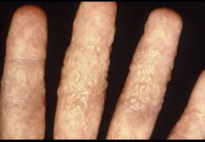
The patient returns to clinic several days after starting griseofulvin therapy. Mother is very concerned because the following lesions developed on his hands and she is asking for your advice. Should you…
Refer the patient to dermatology
Reassurance
Discontinue griseofulvin therapy
Switch to itraconazole therapy for tinea capitis
E) Obtain a punch biopsy of the lesion

Slide 9
The patient returns to clinic several days after starting griseofulvin therapy. Mother is very concerned because the following lesions developed on his hands and she is asking for your advice. Should you…
Refer the patient to dermatology
Reassurance
Discontinue griseofulvin therapy
Switch to itraconazole therapy for tinea capitis
E) Obtain a punch biopsy of the lesion
This is an dermatophytid (Id) reaction which pruritic, papulovesicular eruption which represents an immune response to the fungi.
Notes:
This is an dermatophytid (Id) reaction which represents an immune response to the fungi. It often appears after the initiation of therapy. The patient may develop pruritic, papulovesicular eruptions that can be distant from the site of infection. The patient should continue the full course of anti fungal therapy as treating the underlying cause will lead to resolution of the eruption. Dermatology referral and biopsy are not indicated. An Id reaction is not an adverse reaction to medication.

Slide 10
About tinea capitis
May occur in several different forms, "gray patch," "black dot" and favus.
Black dot tinea capitis is most associated with trychophyton species and is commonly seen in the US.
Hair products, washing and use of oil not implicated in acquiring tinea capitis
Spore control can be achieved with selenium sulfide 2.5% or ketoconazole 2% shampoo applies for 5-10 minutes three times per week. This therapy alone will not treat tinea capitis.
Notes:
Tinea capitis can occur in several different forms, "gray patch," "black dot" and favus. Black dot tinea capitis is most associated with trychophyton species and is commonly seen in the US.
Favus, most often due to Trichophyton schoenleinii
Grey Patch Tinea Capitis is very rare in North America in the endemic form and is often caused by Microsporum canis
Exposure to Trichophyton tonsurans is associated with scalp infection. Hairstyling, frequency of washing, use of oils or grease, and other hair care practices did not appear to play a major role in the acquisition of the disease ⁶

Slide 11
Grey Patch Tinea Capitis

Slide 12
Case #2
The mother of a 4 wk old infant brings her son to your office because she is worried about a red, raised lesion that developed on his upper lip and has progressively increased in size within the last week. Breast feeding has been affected in the last few days. There were no complications with his pregnancy or delivery and mother states that this lesion was not present at his birth.
Identify the lesion pictured in the next slide and discuss other possible diagnoses to consider?
What is the expected natural course of this lesion, when would intervention be indicated?
The patient’s mother asks you what treatments are available for this lesion, what are the options and what is most appropriate for this patient?

Slide 13
Pediatrics In Review: Infantile Hemangiomas: An Update on Pathogenesis and Therapy
Tina S. Chen, Lawrence F. Eichenfield and Sheila Fallon Friedlander Pediatrics 2013;131;99; originally published online December 24, 2012; DOI: 10.1542/peds.2012-1128

Slide 14
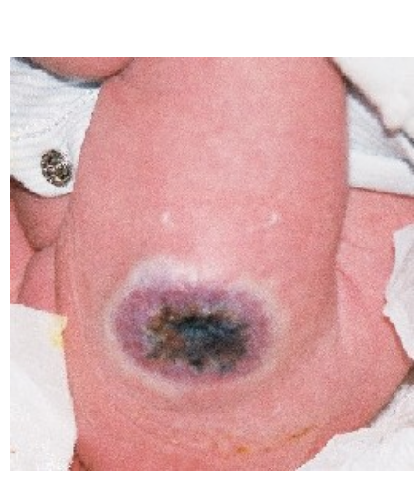
Identify the lesion pictured in the next slide and discuss other possible diagnoses to consider?
This is an infantile hemangioma comprised of proliferating endothelial cells.
blanching lesion then evolves into a red macule
may become dome like, lobulated or plaque like.
In contrast, noninvoluting congenital hemangiomas and rapidly involuting congenital hemangiomas RICH) are present and fully formed at birth and may be ulcerating. They may possess telangiectases and a rim of pallor and typically
involute in the second year of life.
Rapidly Involuting Congenital Hemangioma
Birthmarks.us.case13 Dr. Konez
Notes:
Hemangiomas are the most common soft tissue tumors of infancy. Occur in 5% to 10% of the population (F:M ratio 3:1).
Other considerations:
Capillary malformation (port wine stain), pyogenic granuloma, venous and arterial malformations, and vascular tumors such as tufted angiomas
Cherry Hemangioma
Cobb Syndrome
Dabska Tumor
Lipomas

Slide 15
What is the expected natural course of this lesion, when would intervention be indicated?
Most are cutaneous lesions. They typically undergo a rapid early proliferative phase, reaching their maximum size by 6 to 8 months, followed by a gradual spontaneous involution. 50% resolve completely by age 5, 70% resolve completely by age 7.
Treatment may be indicated in the case of complications such as
Permanent disfigurement or functional compromise
Ulceration
Bleeding
Visual compromise
Airway obstruction
Congestive heart failure
There may be residual scar formation, telangiectasia or loose localized skin (anetodermic) at the site of involution

Slide 16
The patient’s mother asks you what treatments are available for this lesion, what are the options and what is most appropriate for this patient?
Management options include watchful waiting, steroids (topical, systemic, intralesional), surgical therapy (laser, excision)
Observation
Systemic therapy: hydrocortisone vs. propranolol
Topical therapy: may be indicated for small, thin lesions.
Pulsed dye laser: for ulcerated or thin wall lesions. May good good for cosmetic locations (fingers, eyes, lips, nasal tip, ears, face)
Notes:
Observation: If no functional impairment or cosmetically sensitive location, can consider observation of the hemangioma. Follow up should be scheduled based on parental concern, rapidity of progression, potential for functional impairment and complications.
Systemic therapy: hydrocortisone vs. propranolol
Hydrocortisone: Can slow growth and decrease size possibly by inhibiting VEGF A.
Should be administered during the proliferative phase
1-2 month treatment, then taper
Propranolol: No formal consensus of treatment guidelines and when to initiate. Several studies showed propranolol led to fewer surgical interventions and had fewer side effects compared with oral corticosteroids.
Requires initiation of treatment inpatient with close monitoring (HR, BP, blood glucose, bronchospasm)
Treat for an average of 6 months
Interferons: Inhibit endothelial migration and proliferation
Risk for spasticity

Slide 18
Hemangiomas
In a newborn with multiple cutaneous hemangiomas (> 5), screen for visceral hemangiomatosis as these are the most common hepatic vascular lesions found in newborns that often are multiple and involve both lobes.
PHACE Syndrome:
If > 5cm hemangioma on the face, evaluate for PHACE
MRI/ MRA brain, upper chest and neck, CV imaging, optho eval
Notes:
Liver hemangioma: May present clinically as the consequence of secondary anemia and high-output congestive heart failure.
PHACE Syndrome: Posterior fossa brain abnormality, hemangioma, arterial malformations, coarctation of the aorta, eye abnormalities.

Slide 19
Case #3
An infant presents to your clinic as a new patient. During the review of family history, you discover that there are multiple contacts in the family with tuberous sclerosis complex. Parents are concerned that the infant has TS.

Slide 20
The earliest cutaneous manifestation of tuberous sclerosis complex is?
A. Café au lait spots
B. Ash-leaf macule
C. Shagreen patch
D. Facial angiofibromas
E. Periungal fibroma

Slide 21
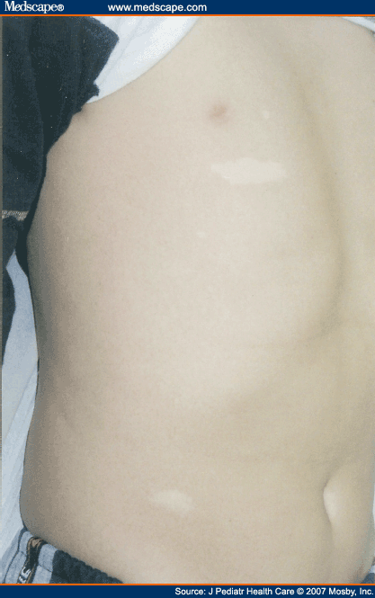
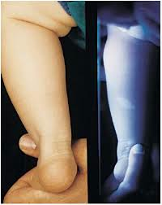
The earliest cutaneous manifestation of tuberous sclerosis complex is?
A. Café au lait spots
B. Ash-leaf macule
C. Shagreen patch
D. Facial angiofibromas
E. Periungal fibroma
Notes:
Hypopigmented or ash-leaf macule(s) may be present early on in infancy, prior to manifestation of other
symptoms such as developmental delay, seizures, behavior problems and autism.
Woods lamp may elucidate macules that are not readily visualized

Slide 22
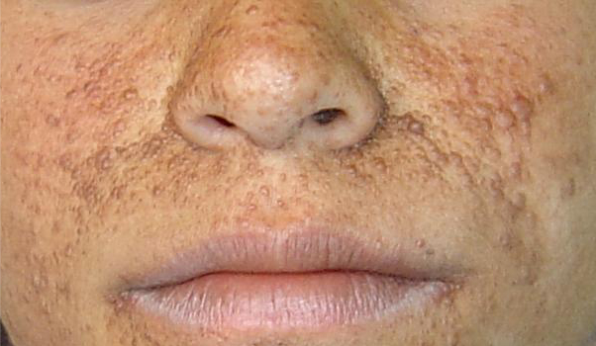
In a patient presenting with the following skin findings, a commonly associated finding is
Axillary freckling
Periungual fibroma
Dental pitting
Comedones on the back
Herald patch

Slide 23
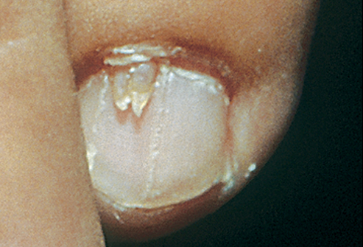
In a patient presenting with the following skin findings, a commonly associated skin finding is
Axillary freckling
Periungual fibroma
Comedones on the back
Herald patch
Scalp hemangiomas
Notes:
Facial angiofibromas area pink or flesh colored, telangiectatic papules that are commonly seen on the cheeks and nasolabial folds. They typically present before age 10, then evolve is size and number until adolescence. They may also present in the oral mucosa, scalp, tongue and nails.

Slide 24
Additional Information
Diagnostic Criteria for TSC
Major features
Facial angiofibroma or forehead plaque
Nontraumatic ungula or periungual fibroma
Hypopigmented macules > 3
Shagreen patch (connective tissue nevus) Multiple retinal nodular hamartomas
Cortical tubera
Subependymal nodule
SGCT
Cardiac rhabdomyomas, single or multiple
Lymphangioleiomyomatosis
Renal angiomyolipoma
Minor features
Multiple randomly distributed pits in dental enamel
Hamartomatous rectal polyps
Bone cysts
Cerebral white matter migration lines
Gingival fibromas
Non renal hamartomas
Retinal achromic patch
Confetti skin lesions
Multiple renal cysts

Slide 25
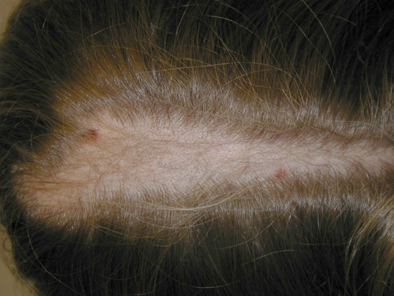
PREP Question
A mother brings her 14-year-old daughter to see you because of hair loss of several weeks’ duration. On physical examination, you see an area of relative alopecia located at the vertex within which are hairs of varying length There is no erythema or scaling of the scalp and no black dot hairs are apparent. During the evaluation, you note that the child seems very shy and that she bites her fingernails. Of the following, the MOST likely diagnosis is
alopecia areata
nevus sebaceus
tinea capitis
traction alopecia
trichotillomania

Slide 26
PREP Question
A mother brings her 14-year-old daughter to see you because of hair loss of several weeks’ duration. On physical examination, you see an area of relative alopecia located at the vertex within which are hairs of varying length There is no erythema or scaling of the scalp and no black dot hairs are apparent. During the evaluation, you note that the child seems very shy and that she bites her fingernails. Of the following, the MOST likely diagnosis is
alopecia areata
nevus sebaceus
tinea capitis
traction alopecia
trichotillomania

Slide 27
PREP Question
A 3-year-old boy is seen for a health supervision visit. He attends a special education preschool program designed for children who have developmental impairments. His mother notes that he has not yet begun to talk, but he appears to understand some of her requests. He is not interested in playing or interacting with other children. He tends to play with objects in a stereotyped fashion, such as pushing the same toy car back and forth repetitively. He insists on only wearing sweatpants and cotton T-shirts, regardless of the weather. The mother's pregnancy and delivery were uneventful. The child has not had any major medical illnesses beyond frequent ear infections. On physical examination, he makes no eye contact and has no spontaneous speech. His height and weight are both at the 50th percentile. Cardiac exam is within normal limits. He has large ears, prominent forehead and a slightly elongated
Of the following, the MOST likely diagnosis is
fetal alcohol syndrome
fragile X syndrome
Rett syndrome
Smith–Lemli–Opitz syndrome
E. tuberous sclerosis

Slide 28
PREP Question
A 3-year-old boy is seen for a health supervision visit. He attends a special education preschool program designed for children who have developmental impairments. His mother notes that he has not yet begun to talk, but he appears to understand some of her requests. He is not interested in playing or interacting with other children. He tends to play with objects in a stereotyped fashion, such as pushing the same toy car back and forth repetitively. He insists on only wearing sweatpants and cotton T-shirts, regardless of the weather. The mother's pregnancy and delivery were uneventful. The child has not had any major medical illnesses beyond frequent ear infections. On physical examination, he makes no eye contact and has no spontaneous speech. His height and weight are both at the 50th percentile. Cardiac exam is within normal limits. He has large ears, prominent forehead and a slightly elongated
Of the following, the MOST likely diagnosis is
fetal alcohol syndrome
fragile X syndrome
Rett syndrome
Smith–Lemli–Opitz syndrome
E. tuberous sclerosis

Slide 29
References and Future Reading
Prep Self Assessment
PIR: Infantile Hemangiomas: An Update on Pathogenesis and Therapy
Initiation and Use of Propranolol for Infantile Hemangioma: Report of a Consensus Conference. Beth A. Drolet et al. Pediatrics 2013;131;128; originally published online December 24, 2012; DOI: 10.1542/peds.2012-1691
Bowers RE, Graham EA, Tomlinson KM. The natural history of the strawberry nevus. Arch Dermatol. 1960;82:667
Tuberous Sclerosis Complex: Diagnostic Challenges, Presenting Symptoms, and Commonly Missed Signs. Brigid A. Staley, Emily A. Vail and Elizabeth A. Thiele Pediatrics 2011;127;e117
Do hair care practices affect the acquisition of tinea capitis? A case-control study. Sharma V, Silverberg NB, Howard R, Tran CT, Laude TA, Frieden IJ. Arch Pediatr Adolesc Med. 2001;155(7):818.
7. Treatment of tinea capitis: beyond griseofulvin.Elewski, B. J Am Acad Dermatol. 1999;40(6 Pt 2):S27.

